Slide 1
Medical Practitioners Assurance Framework (MPAF)
Template slides for Executive Teams & Boards training
January 2020 v1

Slide 2
Overview
The Independent Healthcare Providers Network
Context and ambition of the MPAF
MPAF governance
Regulatory alignment, scope and application of the MPAF
What the MPAF means for boards and executive teams
How [ORGANISATION NAME] is responding to the MPAF

Slide 3
Independent Healthcare Providers Network (IHPN)
[NAME] is a member of IHPN.
IHPN is the UK wide membership association representing independent healthcare providers of NHS and privately funded clinical services
Members deliver a diverse range of services - acute, primary, community, homecare, diagnostic & dental
Members are both ‘for profit’ and ‘not for profit’ – from large international hospital groups to small specialist providers

Slide 4
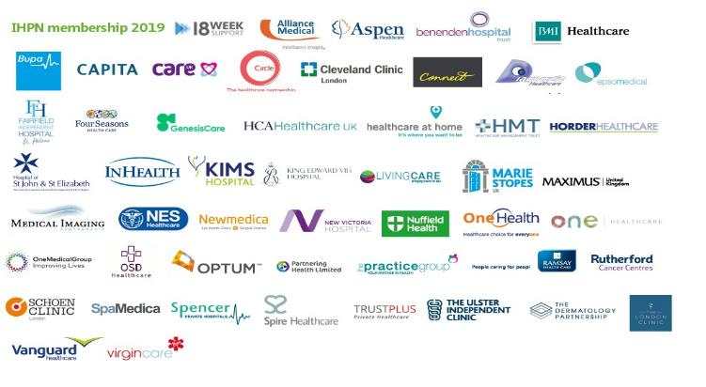
IHPN members

Slide 5
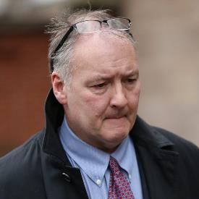
Context of the MPAF - 2018
Notes:
There were three important drivers for the Medical Practitioners Assurance Framework:
In April 2018, the Care Quality Commission (CQC) highlighted clinical and corporate governance within independent hospitals as an area where greater consistency is required to ensure that best practice is universally followed in the “State of care in independent acute hospitals”.
The previous Secretary of State for Health, Jeremy Hunt’s letter to the independent healthcare sector in May 2018 raised concerns around transparency and the monitoring of practising privileges arrangements.
The issues raised through the Ian Paterson Inquiry, which relate to the way in which medical practitioners are overseen within the independent sector.

Slide 6
Ian Paterson Inquiry and the DHSC response
Notes:
The Ian Paterson Inquiry chaired by the Bishop of Norwich Graham James is expected to be published in February/March 2020. The Inquiry will make a series of recommendations to the Department of Health and Social Care (DHSC), its sponsoring government department. IHPN expects the DHSC to accept all the inquiry recommendations. DHSC have informally indicated they plan to establish a sector-level stakeholder group following the Inquiry report that will include IHPN, independent sector providers and relevant external stakeholders to take forward the Inquiry’s recommendations.

Slide 7
Ambition of the MPAF
The MPAF seeks to drive patient safety and quality through an approach aligned to the Kings Fund’s Three Lines of Defence.
It recognises the need to work together as an aligned healthcare system, working with medical practitioners and corporate boards and leaders within clearly defined, open governance structures.
It articulates the standards through which medical practitioners operate and through which healthcare providers hold and are held to account.

Slide 8
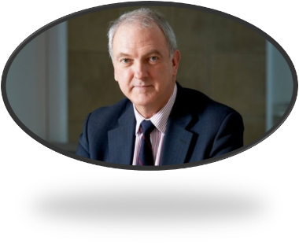
MPAF Governance
MPAF Expert Advisory Group developed the framework
Chaired by Sir Bruce Keogh, former National Medical Director of NHS England
IHPN member and external stakeholder representatives
Widespread consultation with stakeholders
Notes:
The MPAF was developed together with former NHS England National Medical Director, Sir Bruce Keogh with expert input from a balance of IHPN members and key external stakeholders. This governance structure was designed to produce a framework that is truly “owned” by the sector and at the same time being sufficiently independent to command confidence from external stakeholders and work for the entire system.
All IHPN members had an input into the MPAF development through an all member workshop and consultation on the draft document.
Additional stakeholders included consultant representative bodies, information organisations, private medical insurers and government bodies.

Slide 9
Members of the MPAF Expert Advisory Group
Notes:
IHPN member representation on the Expert Advisory Group consisted of Medical Directors, Clinical Governance Directors and General Counsels. The full list of representatives on the Expert Advisory Group is on page 6 of the MPAF.

Slide 10
MPAF Timelines & Review process
MPAF (England) launched at IHPN Summit in October 2019.
Chief Executives of 30 IHPN members wrote to the Secretary of State for Health and Social Care in October 2019 to underline their commitment to implementing the MPAF in their organisations.
MPAF is being adapted to the regulatory context in Scotland, Wales and Northern Ireland.
MPAF is a consensus view of expected practice and will evolve as expected practice evolves. It has an inbuilt annual review process.
IHPN and the MPAF Expert Advisory Group will conduct a “One Year On” Impact study by October 2020.

Slide 11
Regulatory Alignment
MPAF aligns with existing legal and regulatory frameworks: GMC’s Good Medical Practice, Responsible Officer Regulations and CQC’s Well led Key Line of Enquiry.
CQC formally welcomed the MPAF as follows:
“This framework is a welcome development and an important step forward in addressing the need for stronger medical governance across the independent sector. While sign up to the framework is not mandatory or something CQC has the power to enforce, where providers can demonstrate effective and robust implementation of its principles, this will be considered as evidence of good governance and will inform the judgement we make about how well led services being provided by that organisation are.”

Slide 12
Scope of the MPAF
The MPAF applies to all medical practitioners working in independent healthcare settings through practising privileges or on an employed basis.

Slide 13
Application of the MPAF
“One size will not fit all” and the MPAF recognises that organisations have different structures.
Providers should be able to demonstrate how their individual systems and processes meet the expectations of the MPAF. The framework does not require providers to replace structures.

Slide 14
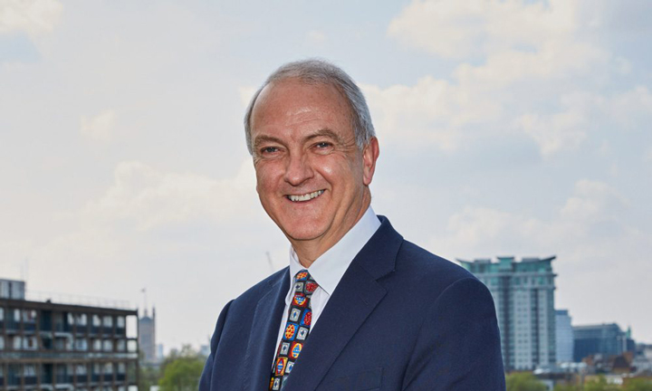
Video Input from Sir Bruce Keogh –
click on the image to play video

Slide 15
Creating an effective medical governance structure for medical practitioners
What are we trying to achieve?
“Independent providers should have transparent and, as far as possible, consistent approaches to clinical governance for doctors in their organisations that support high quality patient care and are well understood by doctors and independent providers.”

Slide 16
What the MPAF means for Boards & Executive Teams
“All independent providers should have a “ward to board” clinical governance structure with clear lines of accountability (up and down the organisation) that as a minimum should:
“Ensure that all board members (or equivalent) are cognisant of their responsibilities for the quality of clinical care. For example, by designating a non-executive board member [ideally with a clinical background] with oversight of clinical governance of medical practitioners.

Slide 17
What the MPAF means for Boards and Executive Teams
“Define the roles and responsibilities of key committees in the clinical governance process for medical practitioners, in particular, the Clinical Governance Committee and the Medical Advisory Committee (or equivalents).
“Define the responsibilities of the key roles relating to the clinical governance of medical practitioners, in particular, the Responsible Officer, Registered Manager, Nominated Individual, Fit and Proper Persons: Directors, Medical Director, Clinical Director, Medical Advisory Committee Chair, Medical Appraisal Leads and Matron/Head of Clinical Services.

Slide 18
What the MPAF means for Boards and Executive Teams
“Specify how information on individual medical practitioners’ performance is collected, reviewed and presented to the hospital management team and how compliance is overseen by the board and
“Define how to communicate governance structures and assurance processes to medical practitioners, patients and to how members of the public might be meaningfully engaged in governance structures.”

Slide 19
What the MPAF means for Boards and Executive Teams of corporate providers
“Corporates with multiple, geographically dispersed locations should appoint a clinician as a national lead for clinical governance. Ideally, this person should be on the executive team and report directly to the Board or relevant board sub-committee. [This role is in addition to the statutory responsibilities of the organisation’s Responsible Officer as defined by legislation. However, the Responsible Officer could also undertake this role depending on the size of the organisation.] To support the national lead for clinical governance they should consider appointing local or regional designated lead consultants for clinical governance of medical practitioners with clearly defined responsibilities.

Slide 20
How [ORGANISATION NAME] is responding/has responded to the MPAF
Review conducted against the four key areas?
Key strengths identified?
Key weaknesses identified?
Next steps for the Executive Team
The support being given to Registered Managers
The support being given to Medical Advisory Teams
Who’s taking the lead
Notes:
This slide to be adapted based on whether the Executive Team has conducted a review of their organisation’s medical governance structures according to the MPAF before presenting to the Board.

